Slide 1
Relevance Ranking
Manish Gupta

Slide 2
Today’s Agenda
Need for Relevance Ranking
TF and IDF
Vector Space Model

Slide 3
Today’s Agenda
Need for Relevance Ranking
TF and IDF
Vector Space Model

Slide 4
Ranked Retrieval
Ch. 6
Thus far, our queries have all been Boolean.
Documents either match or don’t.
Good for expert users with precise understanding of their needs and the collection.
Also good for applications: Applications can easily consume 1000s of results.
Not good for the majority of users.
Most users are incapable of writing Boolean queries.
Most users don’t want to wade through 1000s of results.
This is particularly true of web search.

Slide 5
Problem with Boolean search: Feast or Famine
Ch. 6
Boolean queries often result in either too few (=0) or too many (1000s) results.
Query 1: “standard user dlink 650” → 200,000 hits
Query 2: “standard user dlink 650 no card found”: 0 hits
It takes a lot of skill to come up with a query that produces a manageable number of hits.
AND gives too few; OR gives too many
Notes:
Cf. our discussion of how Westlaw Boolean queries didn’t actually outperform free text querying

Slide 6
Feast or Famine: OK for Ranked Retrieval
Ch. 6
Rather than a set of documents satisfying a query expression, in ranked retrieval, the system returns an ordering over the (top) documents in the collection for a query
When a system produces a ranked result set, large result sets are not an issue
Indeed, the size of the result set is not an issue
We just show the top k ( ≈ 10) results
We don’t overwhelm the user
Premise: the ranking algorithm works. Is it true?

Slide 7
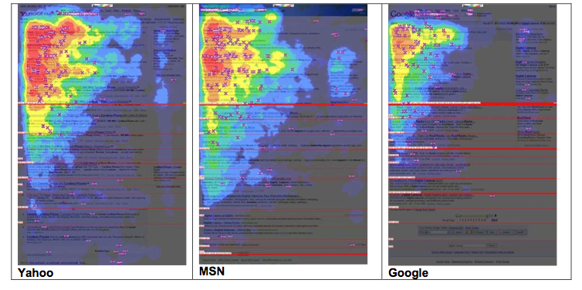
Eye Tracking Study on Search Results
2006
http://www.mediative.com/eye-tracking-google-through-the-years/

Slide 8
Scoring as the Basis of Ranked Retrieval
Ch. 6
We wish to return in order the documents most likely to be useful to the searcher
How can we rank-order the documents in the collection with respect to a query?
Assign a score – say in [0, 1] – to each document
This score measures how well document and query “match.”

Slide 9
Query-Document Matching Scores
Ch. 6
We need a way of assigning a score to a query/document pair
Let’s start with a one-term query
If the query term does not occur in the document: score should be 0
The more frequent the query term in the document, the higher the score (should be)
We will look at a number of alternatives for this.
First take: Jaccard coefficient?

Slide 10
Issues with Jaccard for Scoring
Ch. 6
It doesn’t consider term frequency (how many times a term occurs in a document)
Rare terms in a collection are more informative than frequent terms. Jaccard doesn’t consider this information
We need a more sophisticated way of normalizing for length

Slide 11
Binary Term-Document Incidence Matrix
Sec. 6.2
Each document is represented by a binary vector ∈ {0,1}^{|V|}

Slide 12
Term-Document Count Matrices
Sec. 6.2
Consider the number of occurrences of a term in a document
Each document is a count vector in ℕ^{v}: a column below

Slide 13
Today’s Agenda
Need for Relevance Ranking
TF and IDF
Vector Space Model

Slide 14
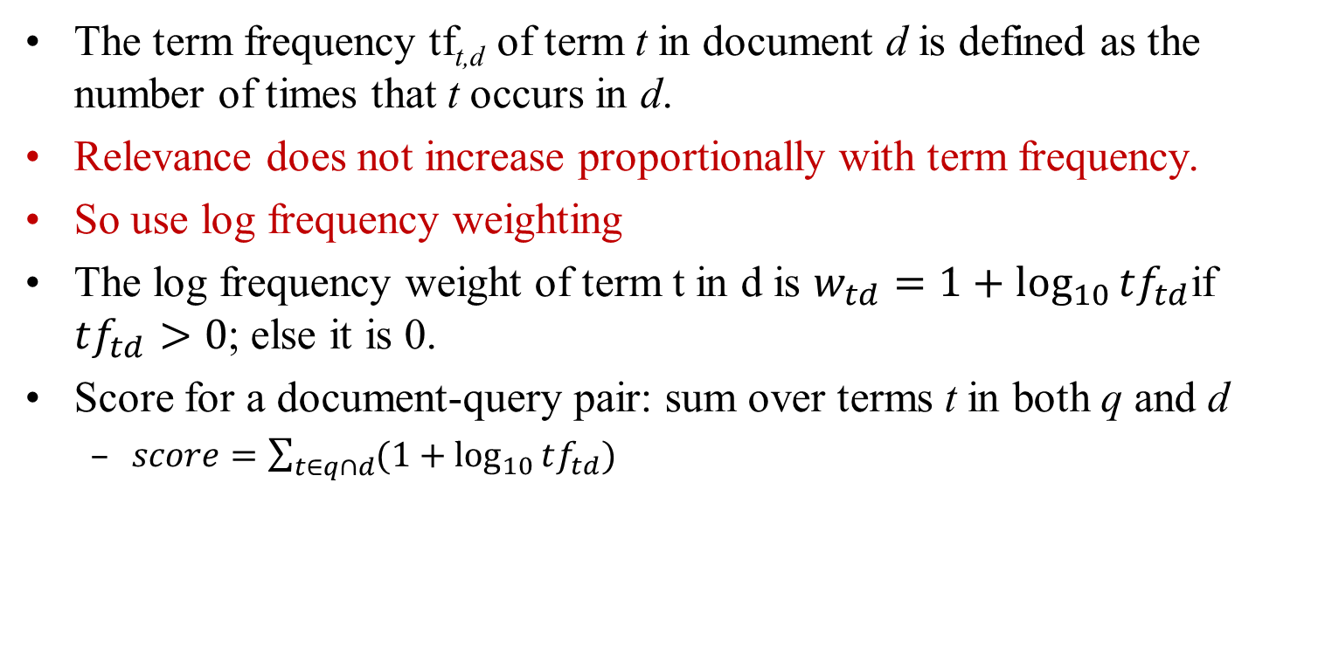
Term Frequency TF
The term frequency tf_{t,d} of term t in document d is defined as the number of times that t occurs in d.
Relevance does not increase proportionally with term frequency.
So use log frequency weighting
The log frequency weight of term t in d is $w_{td}=1+\log_{10}{tf_{td}}$if $tf_{td}>0$; else it is 0.
Score for a document-query pair: sum over terms t in both q and d
$score=\sum_{t∈q∩d}{(1+\log_{10}{tf_{td})}}$

Slide 15
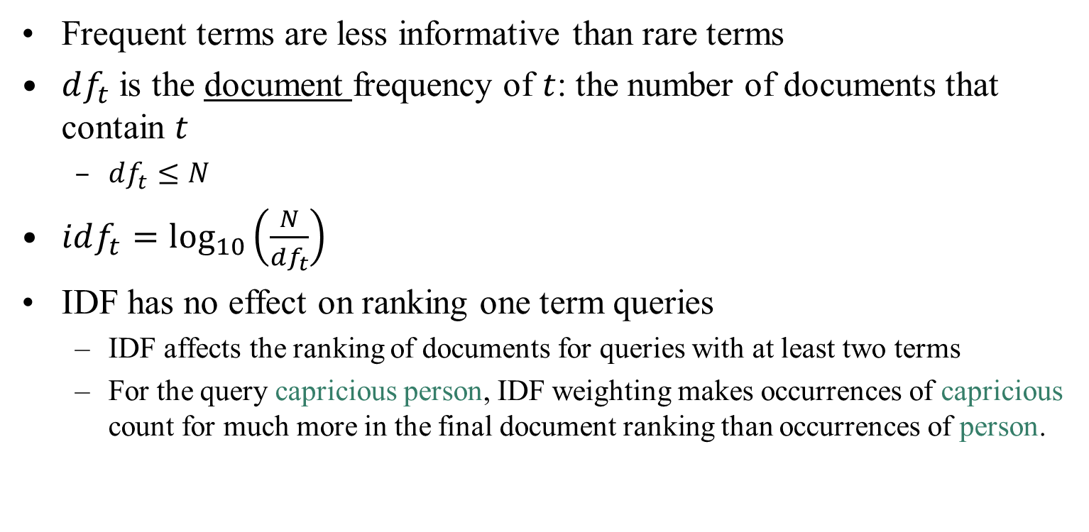
Inverse Document Frequency IDF
Sec. 6.2.1
Frequent terms are less informative than rare terms
$df_{t}$ is the document frequency of $t$: the number of documents that contain $t$
$df_{t}≤N$
$idf_{t}=\log_{10}\left(\frac{N}{df_{t}}\right)$
IDF has no effect on ranking one term queries
IDF affects the ranking of documents for queries with at least two terms
For the query capricious person, IDF weighting makes occurrences of capricious count for much more in the final document ranking than occurrences of person.

Slide 16
TF-IDF Weighting
Sec. 6.2.2
The tf-idf weight of a term is the product of its tf weight and its idf weight.
Score for a document given a query
There are many variants
How “tf” is computed (with/without logs)
Whether the terms in the query are also weighted
…

Slide 17
Binary → Count → Weight Matrix
Sec. 6.3
Each document is now represented by a real-valued vector of tf-idf weights ∈ R^{|V|}

Slide 18
Ranking in Vector Space Model
Represent both query and document as vectors in the |V|-dimensional space
Use cosine similarity as the similarity measure
Incorporates length normalization automatically (longer vs shorter documents)
q_{i} is the tf-idf weight of term i in the query
d_{i} is the tf-idf weight of term i in the document

Slide 19
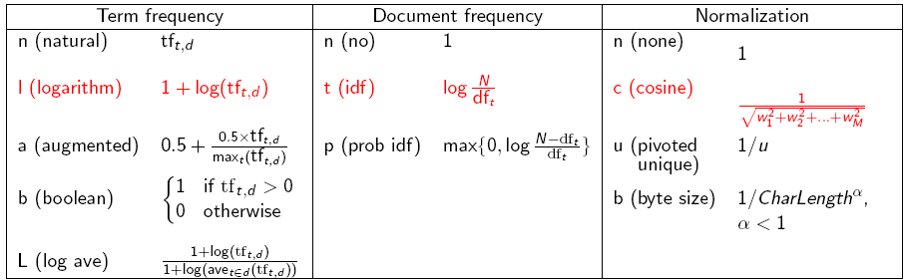
TF-IDF Weighting has many Variants
Sec. 6.4
Columns headed ‘n’ are acronyms for weight schemes.
SMART Notation: denotes the combination in use in an engine, with the notation ddd.qqq, using the acronyms from the previous table
A very standard weighting scheme is: lnc.ltc
Notes:
n default is just term frequency
ltc is best known form of weighting

Slide 20
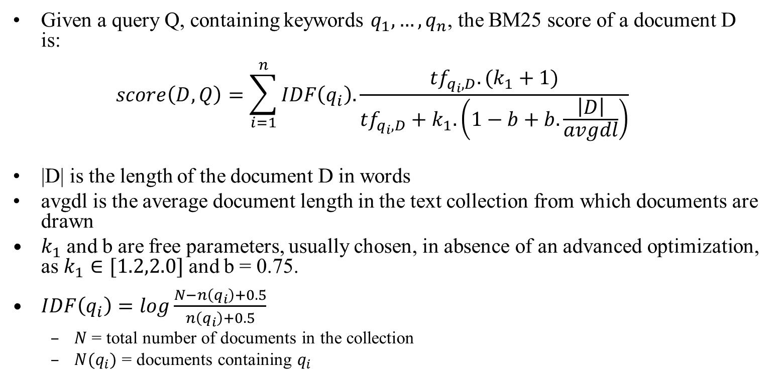
Okapi BM25
Given a query Q, containing keywords $q_{1}, …, q_{n}$, the BM25 score of a document D is: $score\left(D,Q\right)=\sum_{i=1}^{n}{IDF\left(q_{i}\right).\frac{tf_{q_{i}, D}. (k_{1}+1)}{tf_{q_{i},D}+k_{1}.\left(1−b+b.\frac{\left|D\right|}{avgdl}\right)}}$
|D| is the length of the document D in words
avgdl is the average document length in the text collection from which documents are drawn
$k_{1}$ and b are free parameters, usually chosen, in absence of an advanced optimization, as $k_{1}∈[1.2,2.0]$ and b = 0.75.
$IDF\left(q_{i}\right)=log\frac{N−n\left(q_{i}\right)+0.5}{n\left(q_{i}\right)+0.5}$
$N$= total number of documents in the collection
$N(q_{i})$ = documents containing $q_{i}$

Slide 21
Summary – Vector Space Ranking
Represent the query as a weighted tf-idf vector
Represent each document as a weighted tf-idf vector
Compute the cosine similarity score for the query vector and each document vector
Rank documents with respect to the query by score
Return the top K (e.g., K = 10) to the user

Slide 22
Today’s Agenda
Need for Relevance Ranking
TF and IDF
Vector Space Model

Slide 23
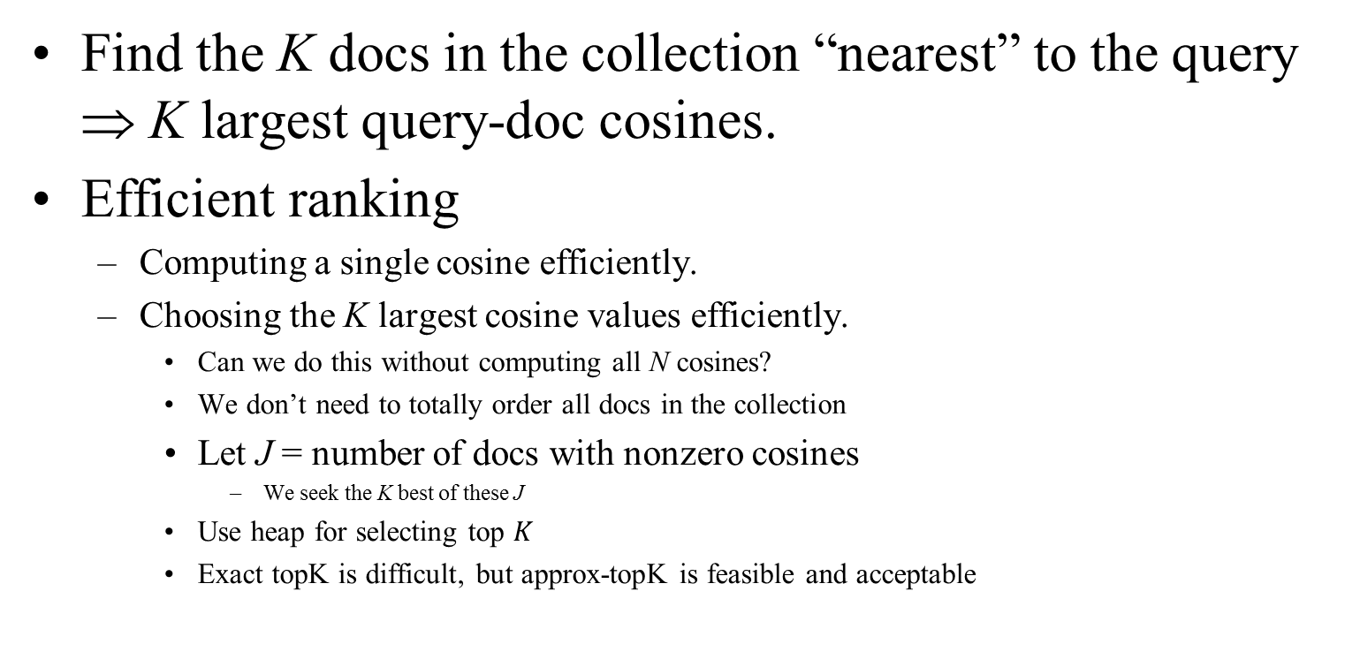
Efficient Cosine Ranking
Find the K docs in the collection “nearest” to the query ⇒ K largest query-doc cosines.
Efficient ranking
Computing a single cosine efficiently.
Choosing the K largest cosine values efficiently.
Can we do this without computing all N cosines?
We don’t need to totally order all docs in the collection
Let J = number of docs with nonzero cosines
We seek the K best of these J
Use heap for selecting top $K$
Exact topK is difficult, but approx-topK is feasible and acceptable

Slide 24
Generic Approach
Find a set A of contenders, with K < |A| << N
A does not necessarily contain the top K, but has many docs from among the top K
Return the top K docs in A
Think of A as pruning non-contenders

Slide 25
Index Elimination
Basic algorithm only considers docs containing at least one query term
Take this further
Only consider high-idf query terms
Only consider docs containing many query terms

Slide 26
Champion Lists
Precompute for each dictionary term t, the r docs of highest weight in t’s postings
Call this the champion list for t
(aka fancy list or top docs for t)
Note that r has to be chosen at index time
At query time, only compute scores for docs in the champion list of some query term
Pick the K top-scoring docs from amongst these

Slide 27
Static Quality Scores
We want top-ranking documents to be both relevant and authoritative
Relevance is being modeled by cosine scores
Authority is typically a query-independent property of a document
Examples of authority signals
Wikipedia among websites
Articles in certain newspapers
A paper with many citations
Many diggs, Y!buzzes or del.icio.us marks
(Pagerank)
Assign to each document a query-independent quality score in [0,1] to each document d
Denote this by g(d)

